Slide 1


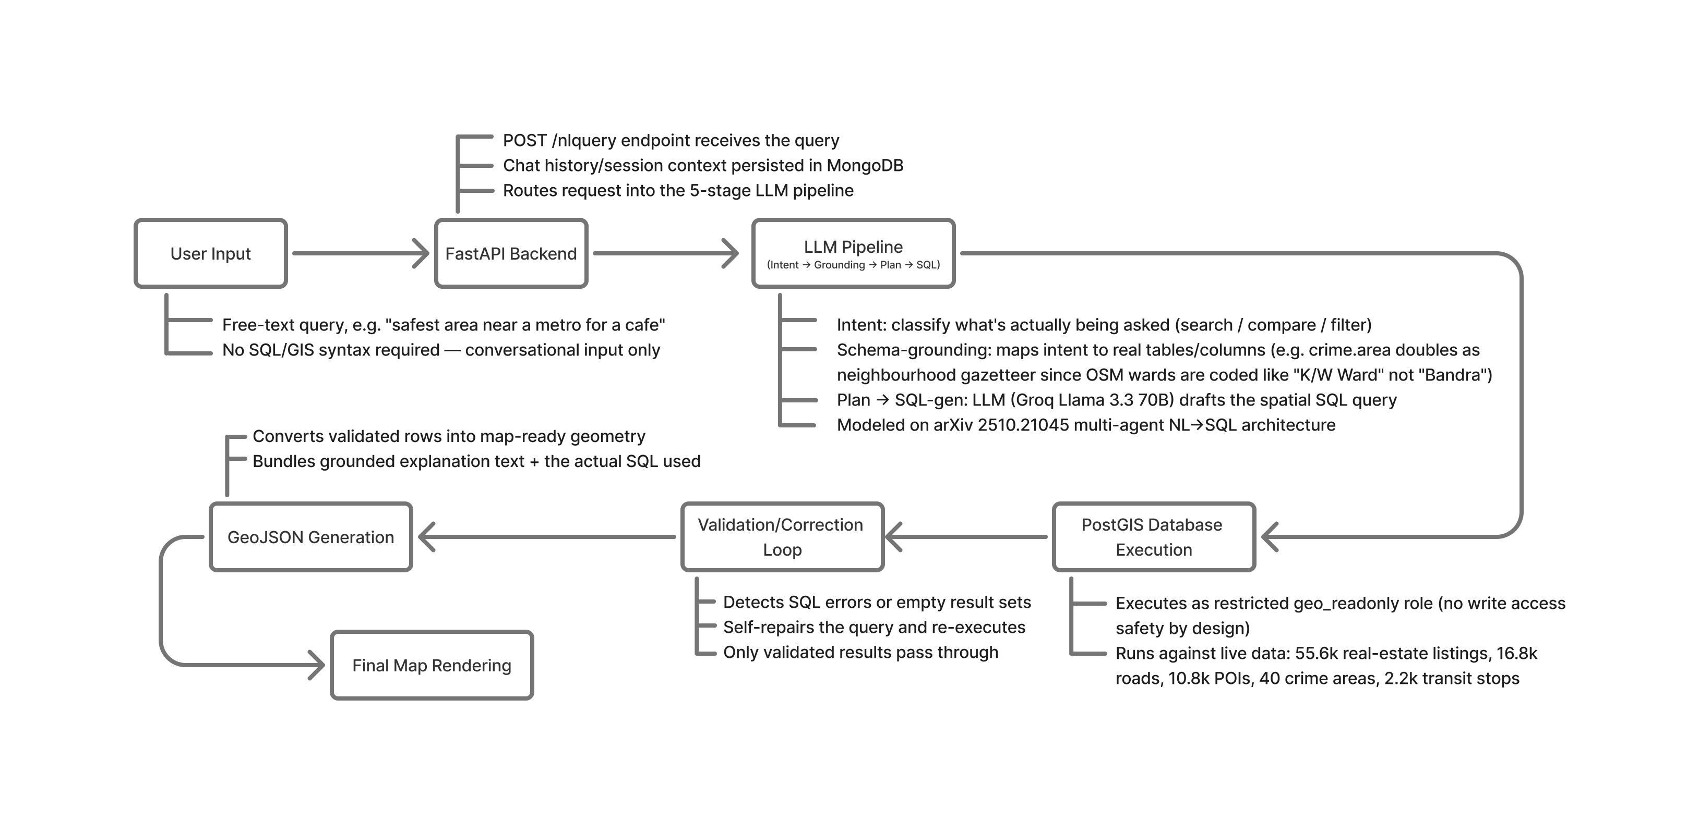
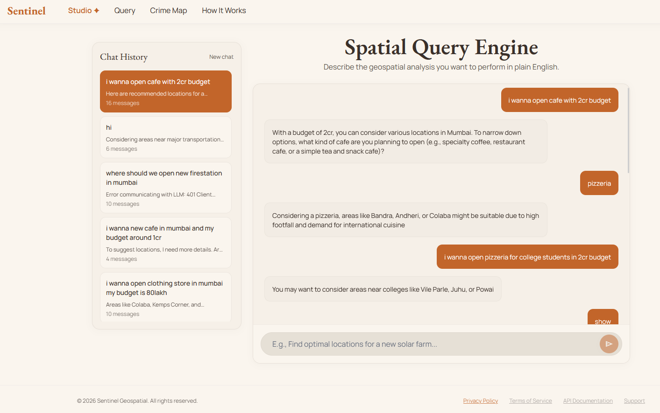
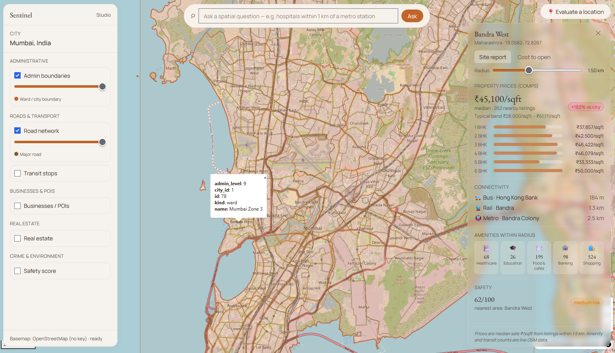


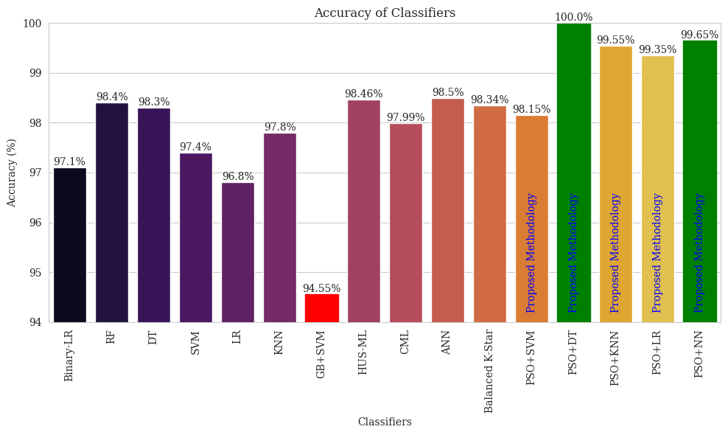
K. J. SOMAIYA INSTITUTE OF TECHNOLOGY
Department of Artificial Intelligence and Data Science
Geospatial Query System with Natural Language Processing and GIS Integration
Riddhesh Chaudhary, Arpit Balmiki, Chirayu Vyas
Guide: Dr. Vaishali Wadhe
Abstract
Choosing where to open a business usually means weeks of manual surveys and scattered research across maps, listings and reports. This project presents a natural-language spatial intelligence platform for real estate and business site selection in Mumbai. A user asks a question in plain English, such as “safest area near a metro for a cafe”, and an LLM pipeline translates it into verified spatial SQL over a live PostGIS database of roads, points of interest, real estate listings, crime zones and transit stops. The answer is returned as an interactive map with a short explanation, the generated SQL and a data-grounded budget estimate, turning a multi-week survey into a single instant query.
Background
Traditional GIS tools demand expertise in spatial data, SQL and specialised software, which keeps location intelligence out of reach for most businesses. Recent work on LLM-based GIS and spatial Text-to-SQL (LLM-Geo, NALSpatial, GS-SQL, GeoLLM) is promising, but still lacks query testing and logging, depends on predefined mapping rules, and struggles with multi-entity spatial reasoning and distance errors. Our system addresses these gaps with schema-grounded intent parsing, multi-step query planning, metre-accurate distance handling and a validation loop before execution, all grounded in real city data.
Figure 1: Natural-language query interface
Objectives
Simplify site selection so businesses can find and evaluate new locations without manual survey work.
Generate automatic, data-grounded cost estimates (rent, setup, licenses) for any chosen spot.
Compare locations side by side on nearby comparables, footfall, amenity density, safety and transit access.
Replace scattered research across sources with a single natural-language query.
Save time and cost with instant, grounded answers instead of weeks of on-ground survey.
Acknowledgement
This research work is supported by K. J. Somaiya Institute of Technology.
Methodology
A FastAPI backend receives the plain-English query and passes it to an LLM pipeline that classifies intent, grounds it in the database schema, plans the query and generates spatial SQL. The SQL runs on a PostGIS database, and a validation and correction loop re-plans any query that fails or returns empty results. Validated results are converted to GeoJSON and rendered on an interactive MapLibre map.
Figure 2: Proposed Methodology
Result and Discussion
The platform runs on live Mumbai data: 48 administrative boundaries, 16,800+ road segments, 10,800+ points of interest, 55,600+ real estate listings, 2,200+ transit stops and 40 crime-safety zones. Answers arrive in seconds with a map, an explanation and the SQL behind them. In evaluation, it estimated about ₹62 lakh to open a café in Bandra and about ₹1.3 crore for a premium restaurant in Lower Parel.
Figure 3: Map-based answer with area statistics and budget estimate
Conclusion
Natural-language spatial intelligence makes location decisions accessible to businesses without GIS or data teams. One verifiable query interface replaces weeks of scattered research, and the city-agnostic design allows extension well beyond Mumbai.
References
[1] A. K. Kazazi, Z. Li, M. N. Lessani, and G. Cervone, “From Questions to Queries: An AI-powered Multi-Agent Framework for Spatial Text-to-SQL,” arXiv, 2025.
[2] X. Zhang, F. Xiao, L. Yan, and Z. Zhang, “GS-SQL: Modeling Spatial Semantics in Spatial Text-to-SQL,” IJCNN, 2024.
[3] J. Malczewski, “GIS-based multicriteria decision analysis: a survey of the literature,” Int. J. Geographical Information Science, vol. 20, no. 7, pp. 703–726, 2006.
[4] Felt, “Felt AI: AI-powered GIS and mapping platform,” Felt Help Center, 2025. [Online]. Available: https://help.felt.com/felt-ai

